Slide 1



Zip Code Analysis
-Author-
Amber Paige Webber

Slide 2
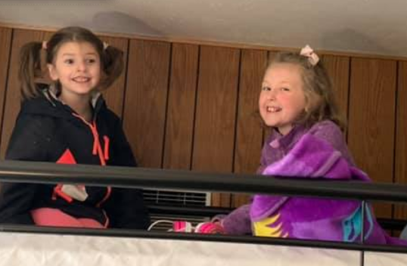
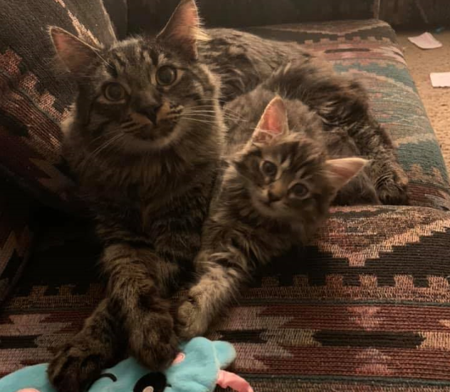

About The Coopers:
A Family of 4
2 Children, 7 Years Old & 10 Years Old
2 Asshole Cats, Loki & Bjorn
Requirements for the Coopers:
Highly Rated Schools Nearby
Low Crime Area
3 Bedrooms Minimum
2 Bathrooms Minimum
Fenced Yard
Budget: $1.5 Million

Slide 3
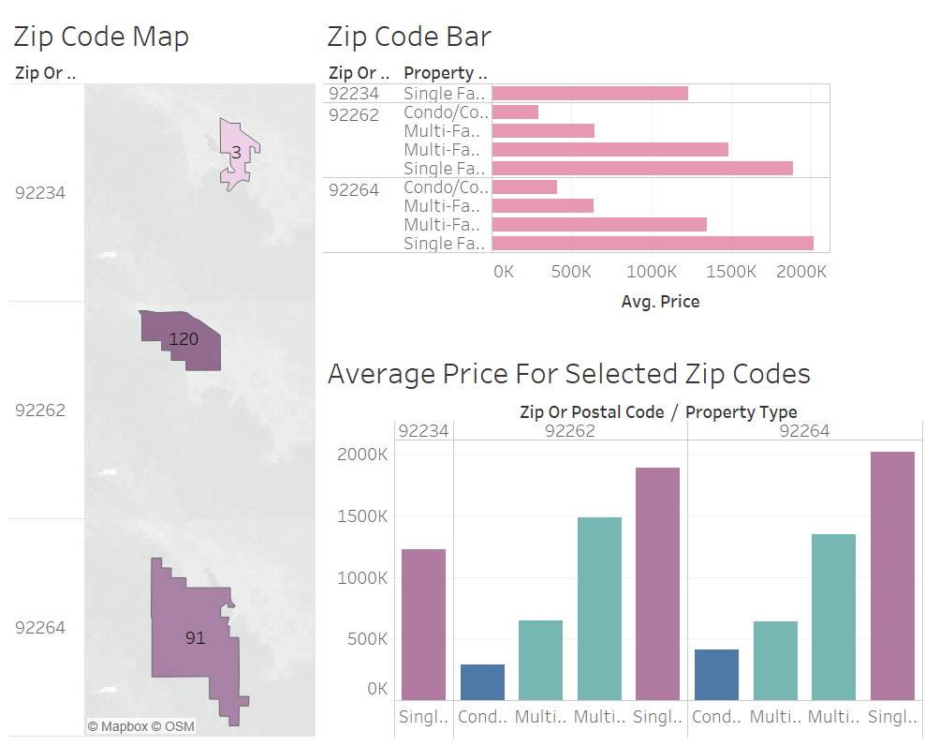
Zip Codes in the region that have property types that are relevant to the Coopers.

Slide 4
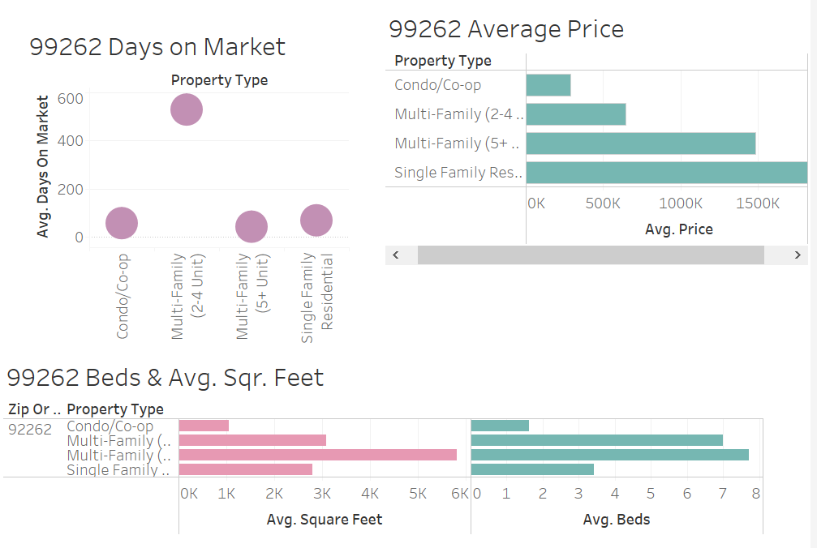

Slide 5
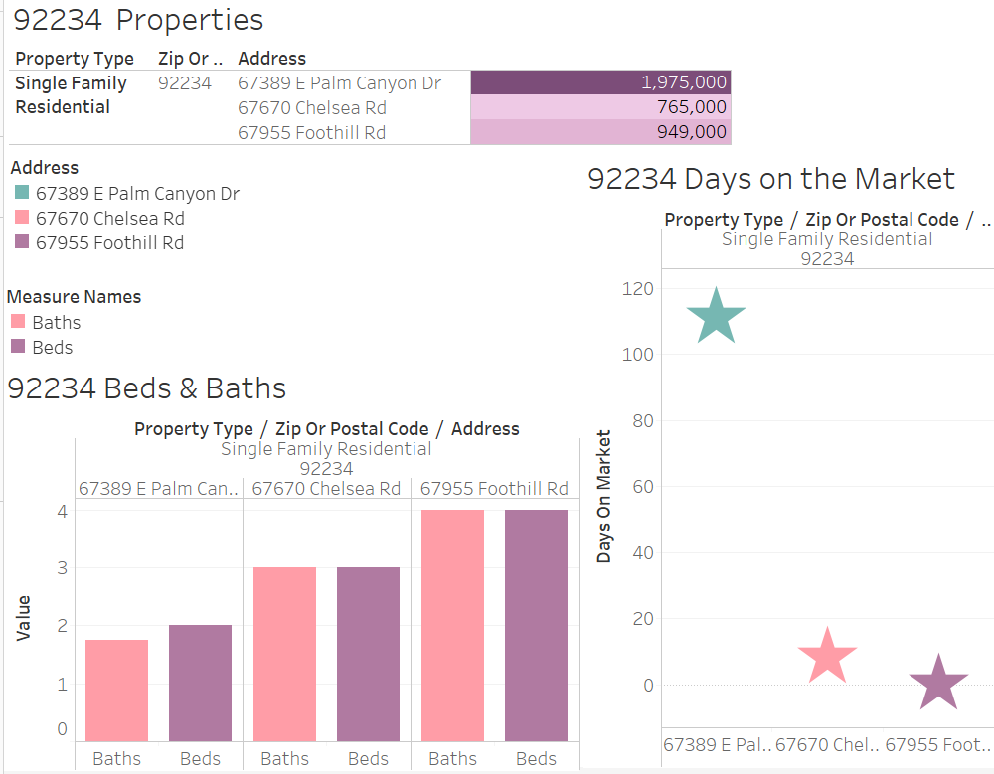

Slide 6
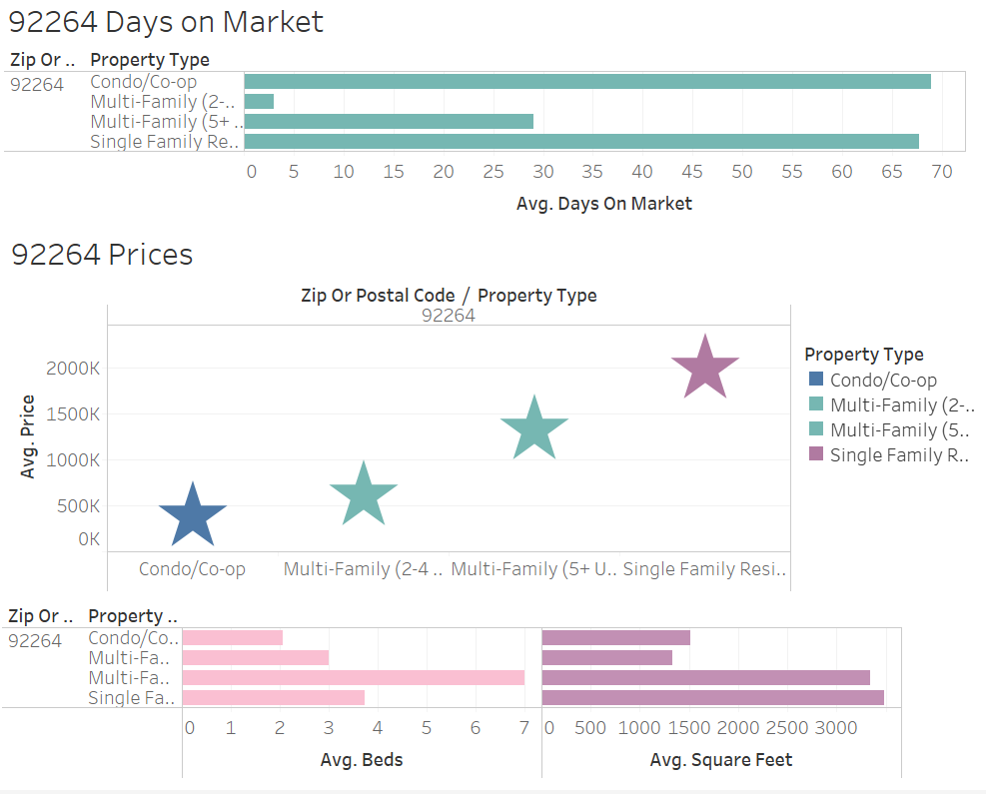

Slide 7
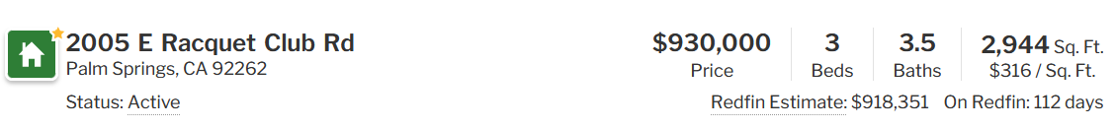
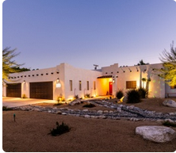
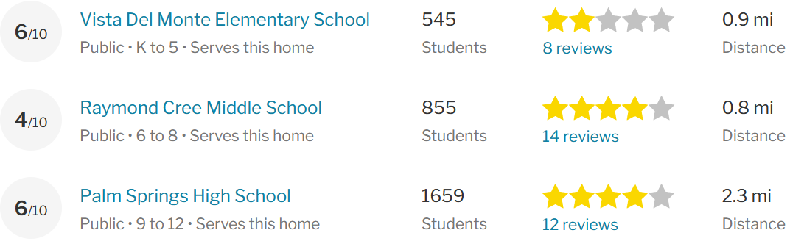
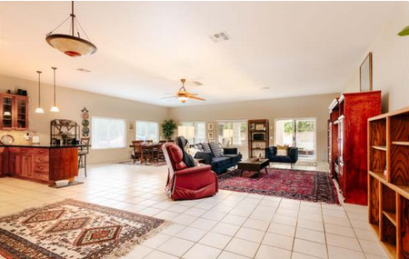
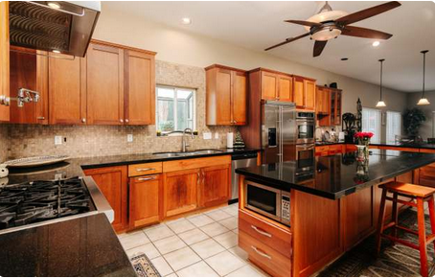
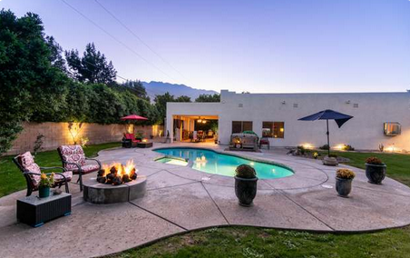

Slide 8
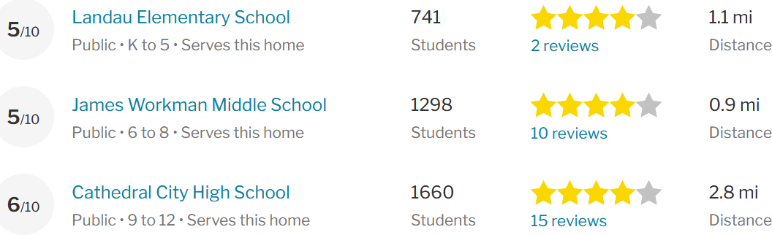
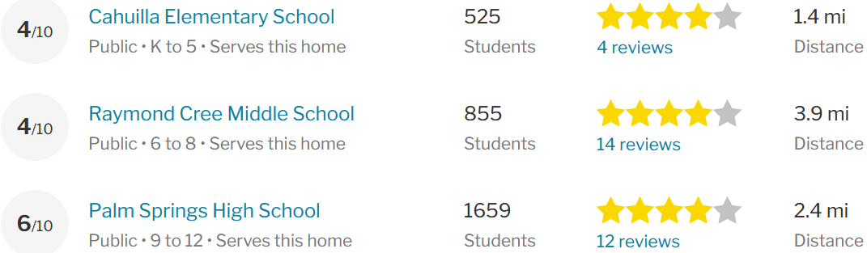
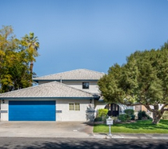
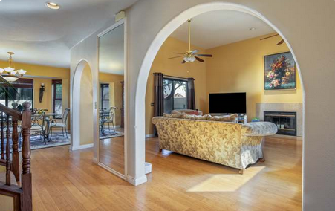
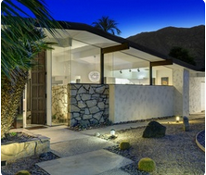
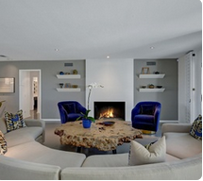
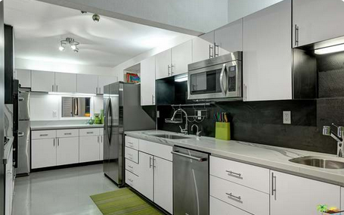
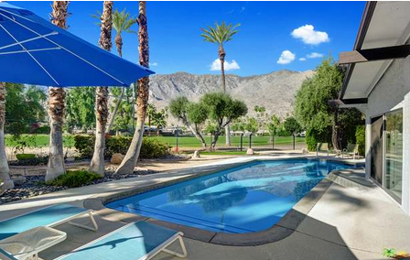
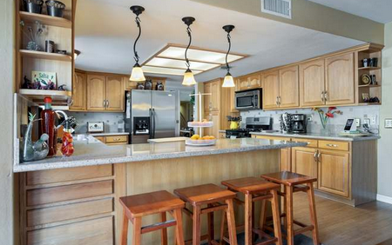
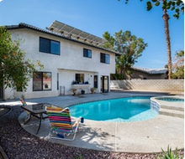

Slide 9

Recommendations:
Highly recommending the 2005 E Racquet Club Dr. in 92262 area.
Schools are close to the property.
It already has a built-in fire pit, that Mrs. Cooper had mentioned adding to a new home.
It’s well within the family budget.
The home is in a great neighborhood.
It’s 5 minutes away from Palm Canyon Dr. which has many restaurants, and the Coopers are self-proclaimed “Foodies”.

Slide 10
HW#4 Feedback/Rubric Score: /20
Complete requested technical work in Tableau: /10
4 areas of analysis (zip code, property type, plus two additional)
Or equivalent work if you chose a different data source
A Tableau Dashboard
A Tableau Story
A map visualization
A Packaged workbook (.twbx file)
Professional presentation and analysis: /10
Client introduced
Presentation tells a story
Story improved over HW #3
Final recommendations supported by data and visualizations
Professional slides

